Slide 1
A Website for helping people in a Natural Disaster
Professor:
Dr. Soma Datta
By:
Agile Class (Spring 2018)
SWEN 5931.05

Slide 2
Table of Contents
Introduction
Technology & Methodology
User Stories & Sprints
Design
Assignment Problem
Test Cases
Demo
Future
Conclusion
References

Slide 3

Introduction
Saving Hands
Helping people in need at the time of any disaster.

Slide 4
What is it about?
The project is building website for
Volunteering for a disaster by providing help
Donations to people in need in a natural disaster
So, it is all about helping people in a natural disaster through different ways.

Slide 5
Why?

Slide 6
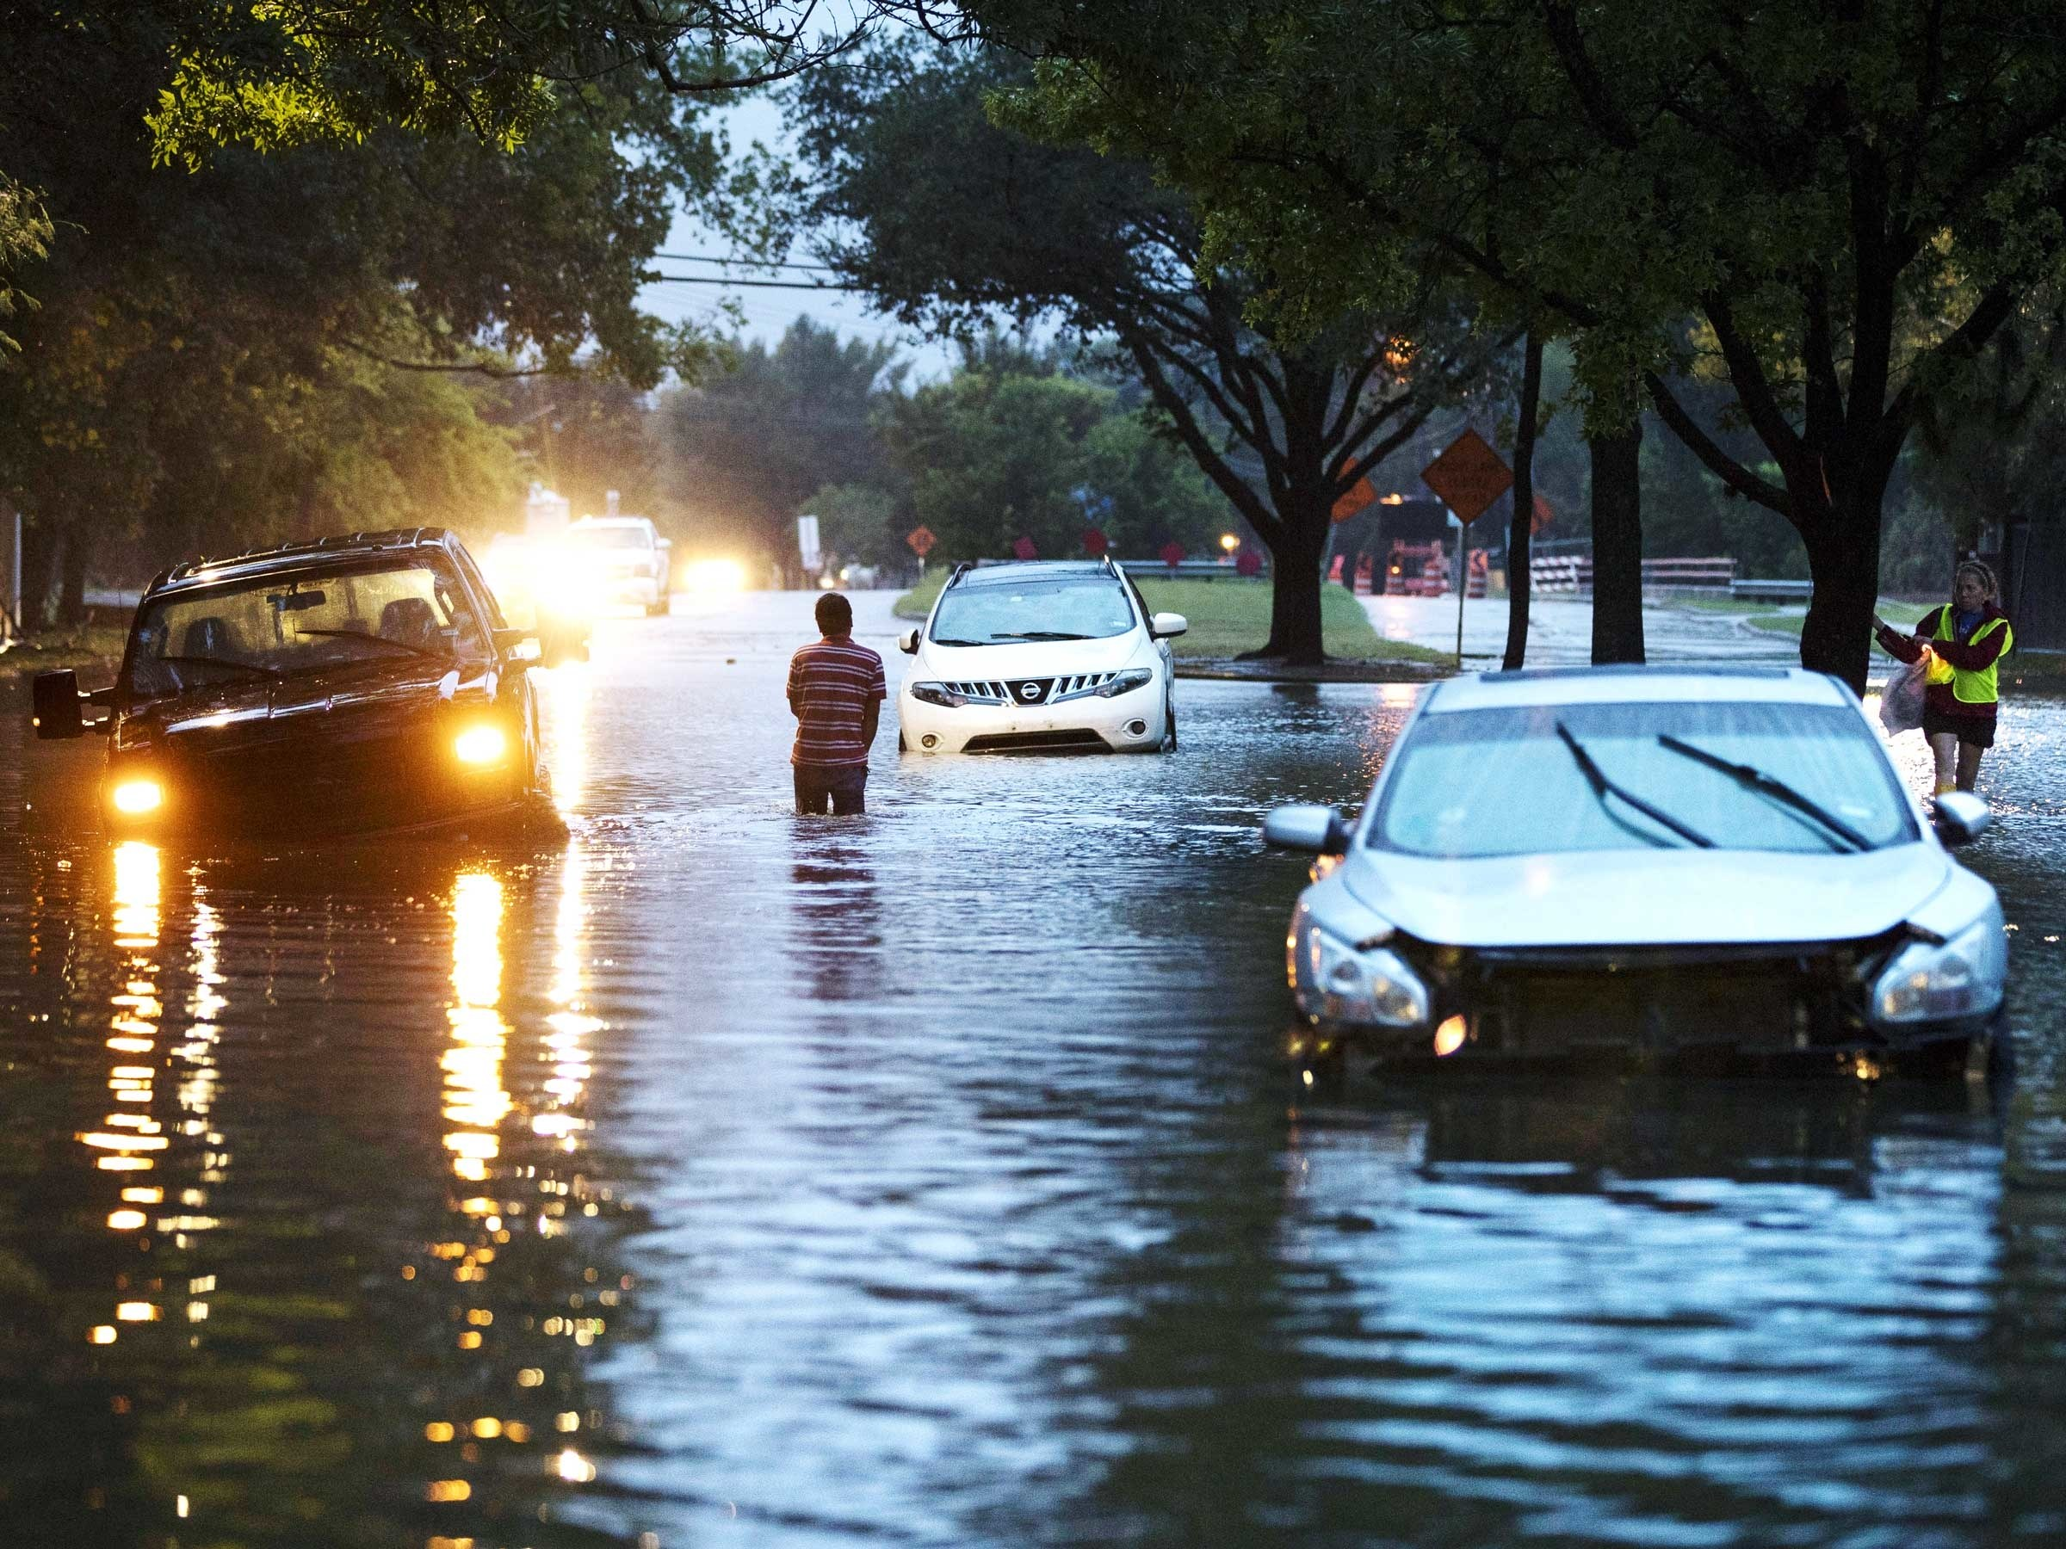

Slide 7
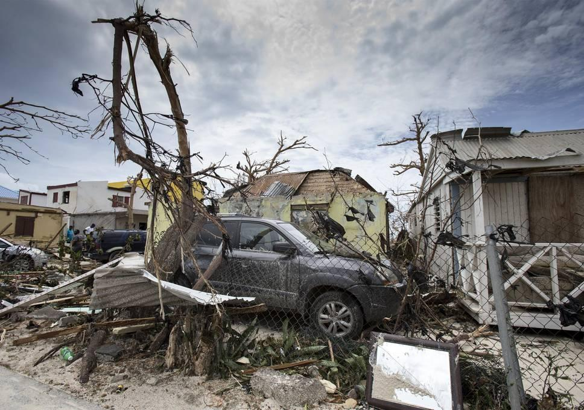

Slide 8
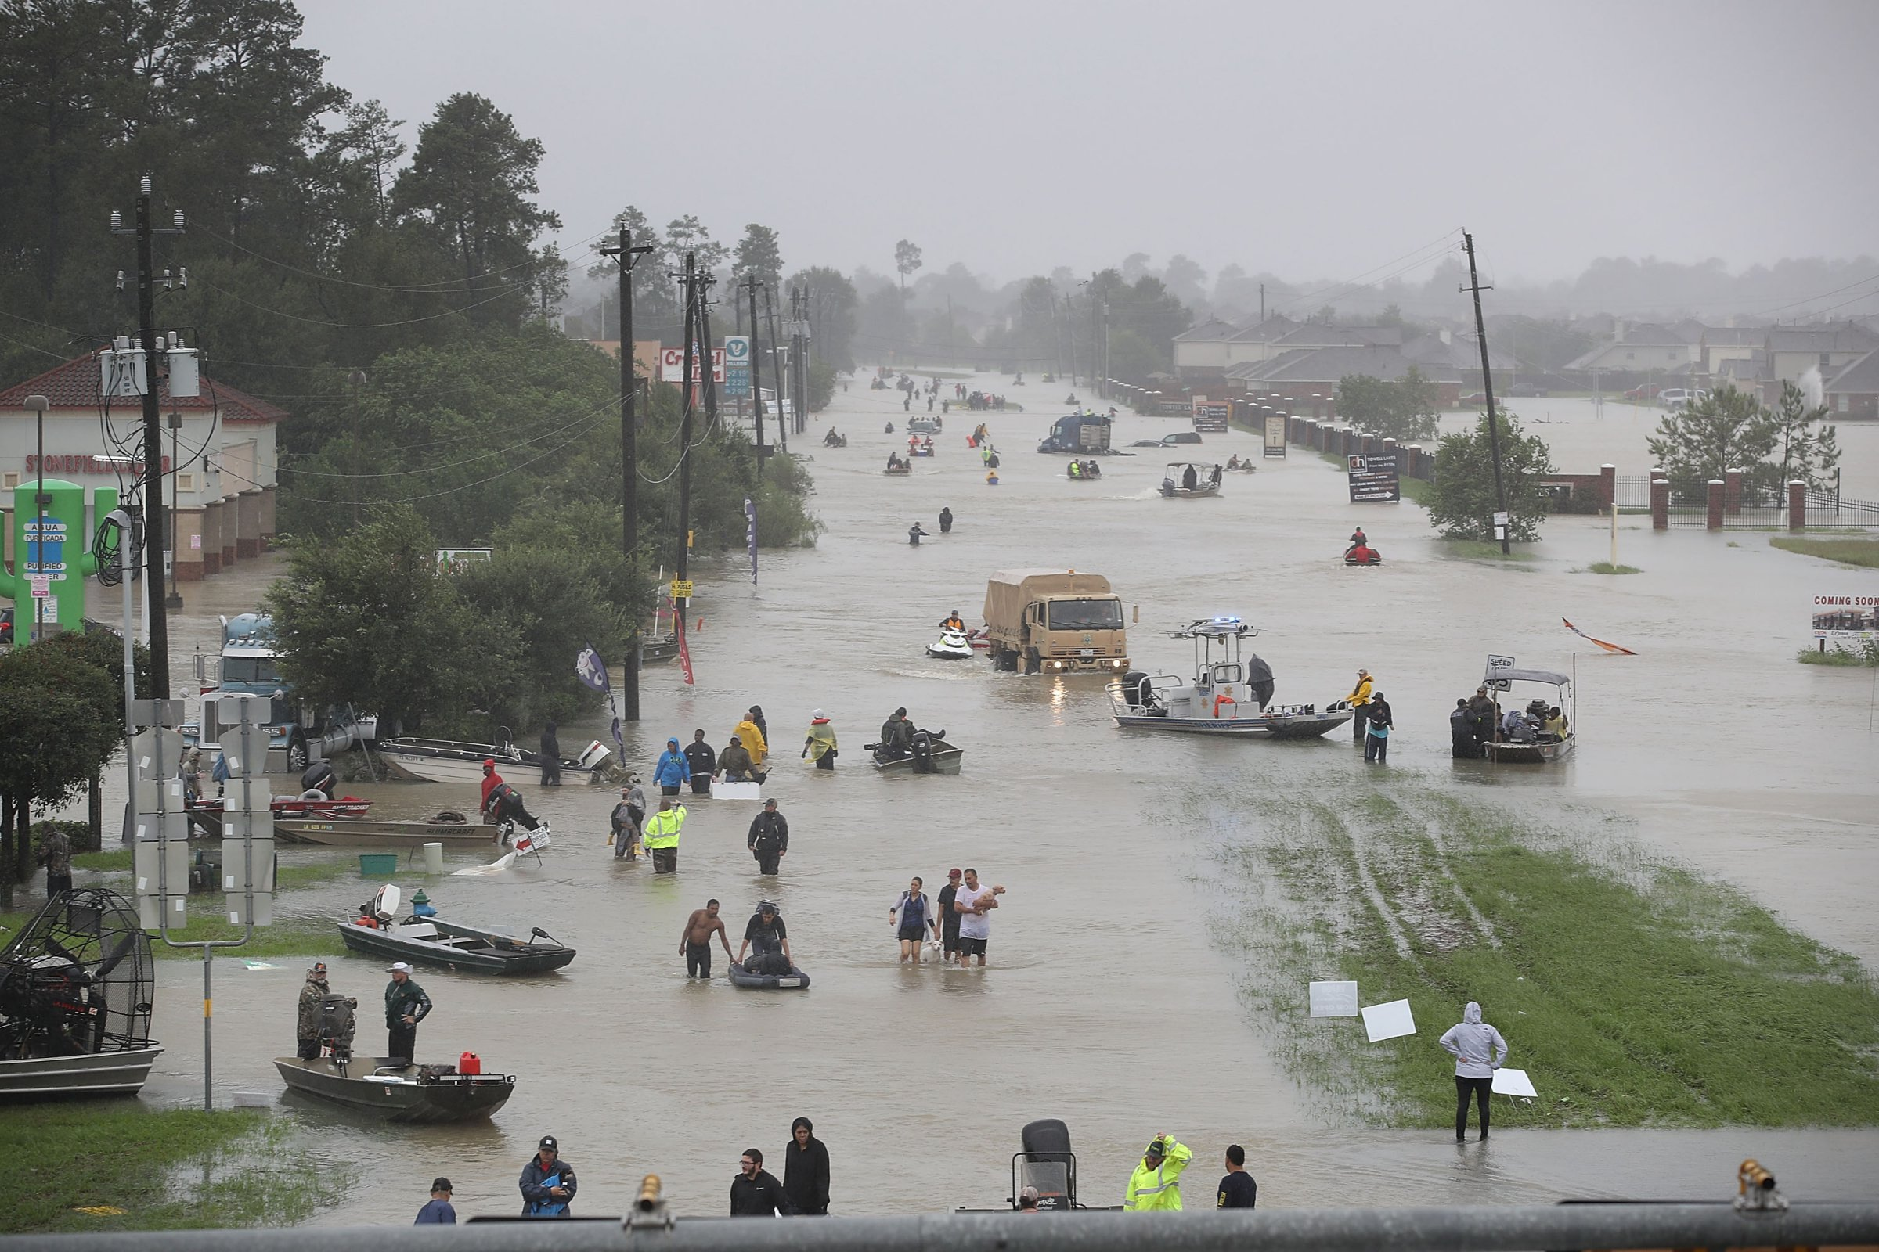

Slide 9


Slide 10
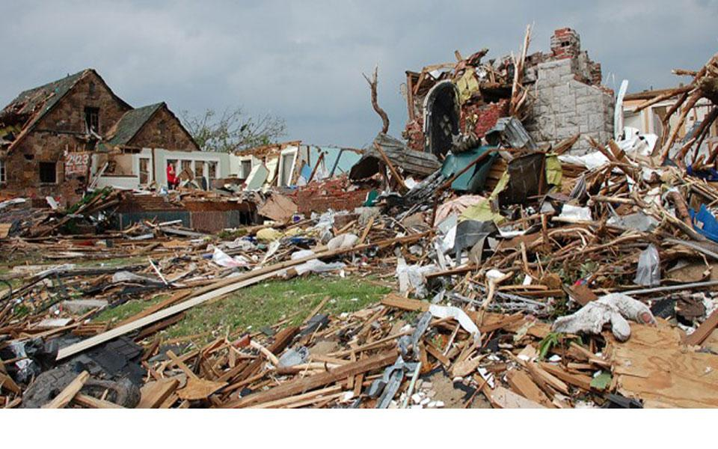

Slide 11




How are we doing it?
Through different sources using our website.

Slide 12

Technology
& Methodology

Slide 13
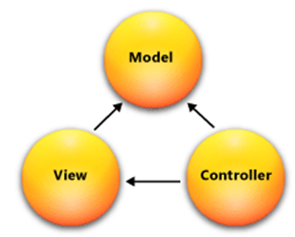
Technology used
ASP.NET
HTML and C#
MVC Framework
MySQL Database
Distance Matrix API
Assignment Algorithm
Hungarian Algorithm

Slide 14
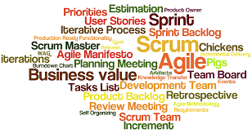
Scrum Methodology
In Scrum, we divide the project into sprints where we have some executable product given to the client in each sprint. We have three roles scrum team, scrum master and product owner. We even had retrospective meetings.

Slide 15
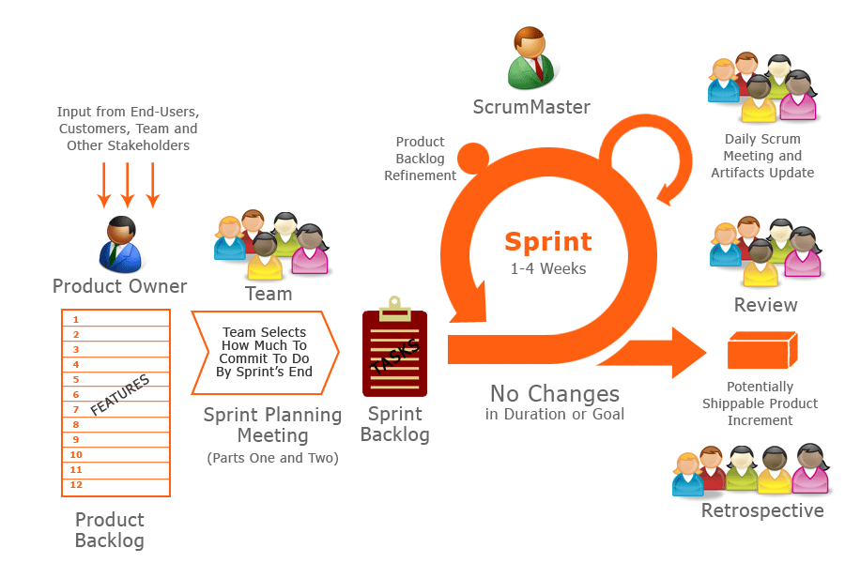
We used Scrum in our project, by using the concept of sprints and did try to give out executable product at end of every sprint.

Slide 16
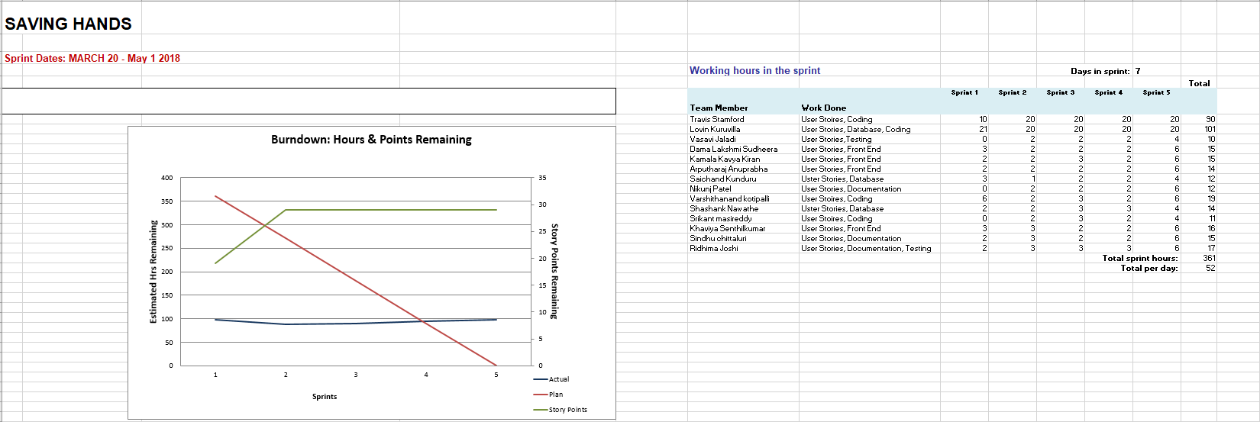
BURNDOWN CHART

Slide 17

Kanban Method
A Kanban method has a board which has specific columns and cards in each column representing a user story.

Slide 18
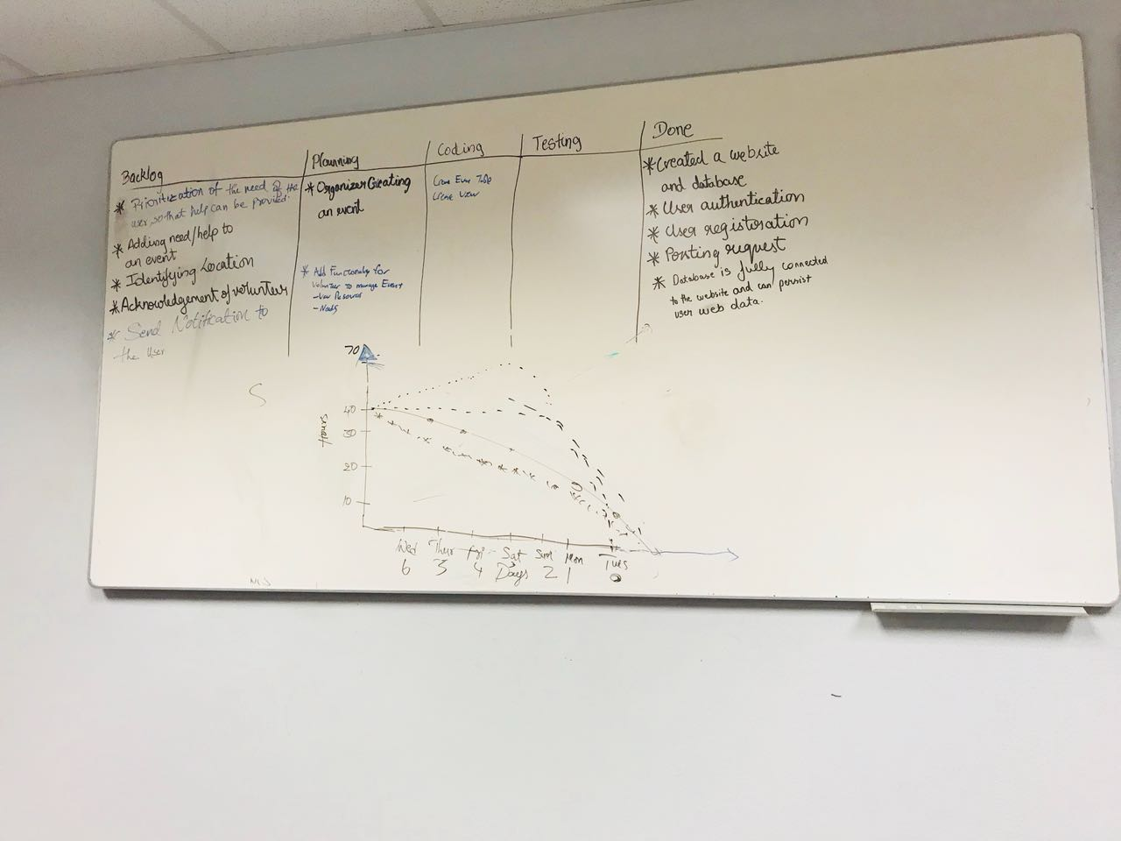

Slide 19

Extreme Programming (XP)
XP is where we come across the concept of pair programming where two programmers work on coding together, where we have one as driver and other as observer and they keep changing their roles.

Slide 20

XP is used in our project as we had two programmers working together on the coding part of our project.

Slide 21
User Stories and Sprints

Slide 22

Iceberg used for prioritizing user stories
High
Medium
Low
Diagram featured by http://slidemodel.com

Slide 23
User Stories
Blue(high priority)
Green(next priority)
Yellow(last priority)
As organizer, I want to prioritize need.
As a user want to register as a volunteer
As organizer want to assign events.
As a volunteer want to help through some way.
As organizer, want to create event .
As organizer want to merge events
As user want to tag my location
As user want to provide information about myself to all.
As organizer want to add resources to needy.

Slide 24
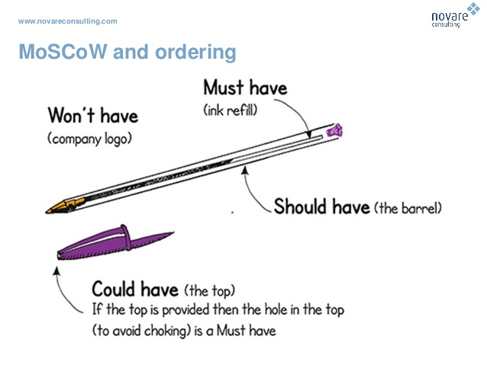
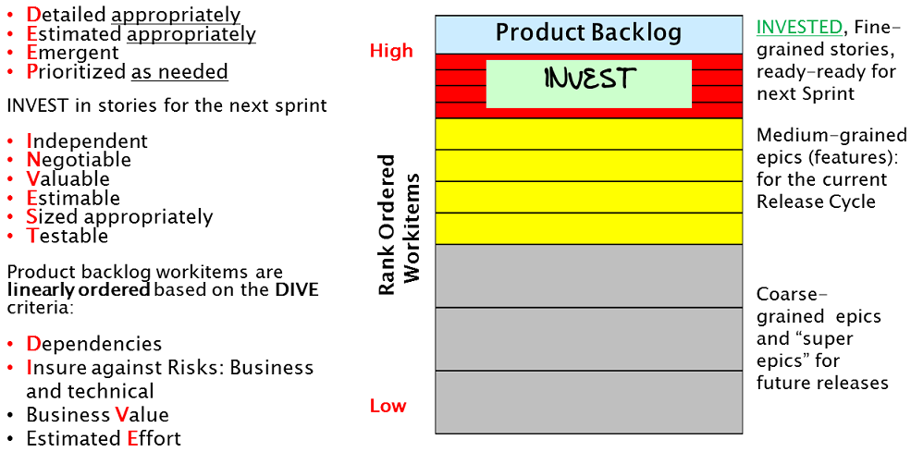
Technique of MOSCOW & DEEP

Slide 25
Sprint
1
Let’s start with the first sprint and experiences.

Slide 26
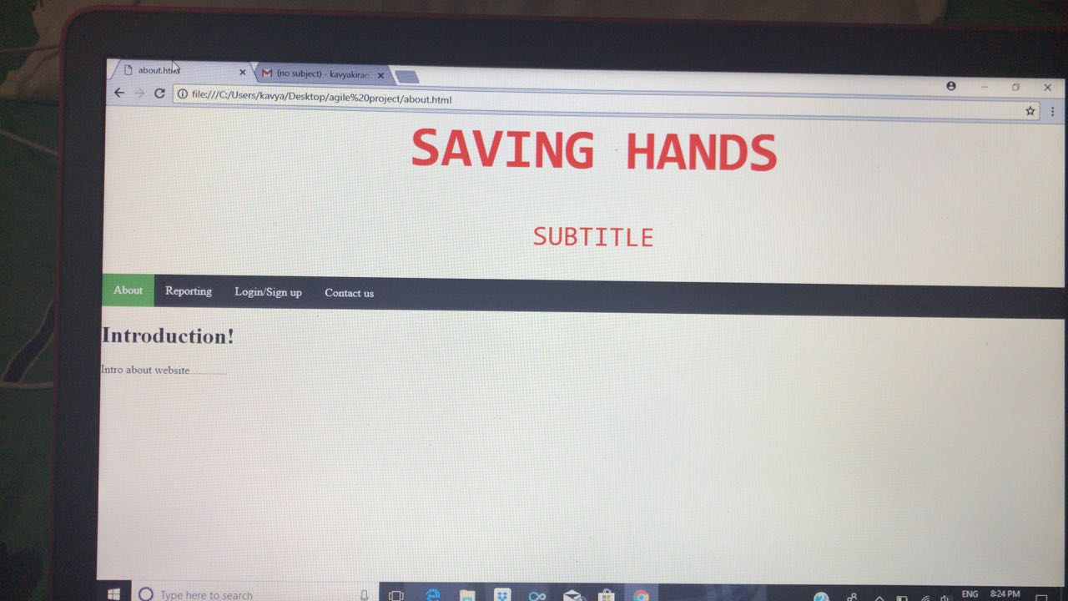

Slide 27
Sprint
2
Let’s go with the second sprint and experiences.

Slide 28
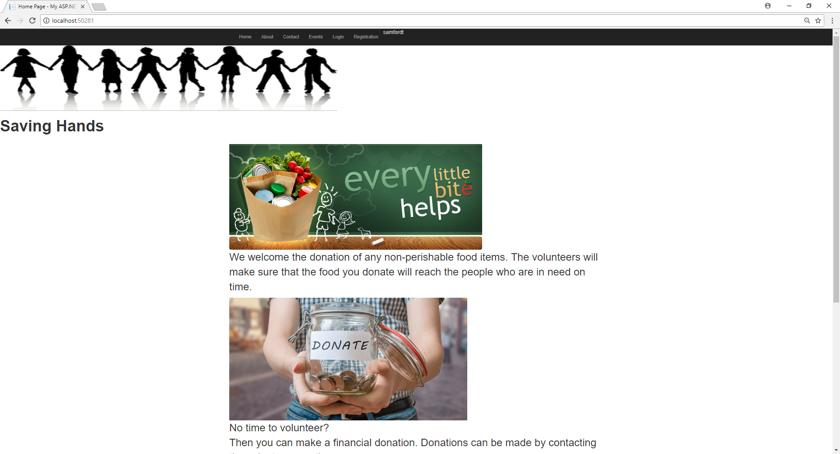
Basic Home Page

Slide 29
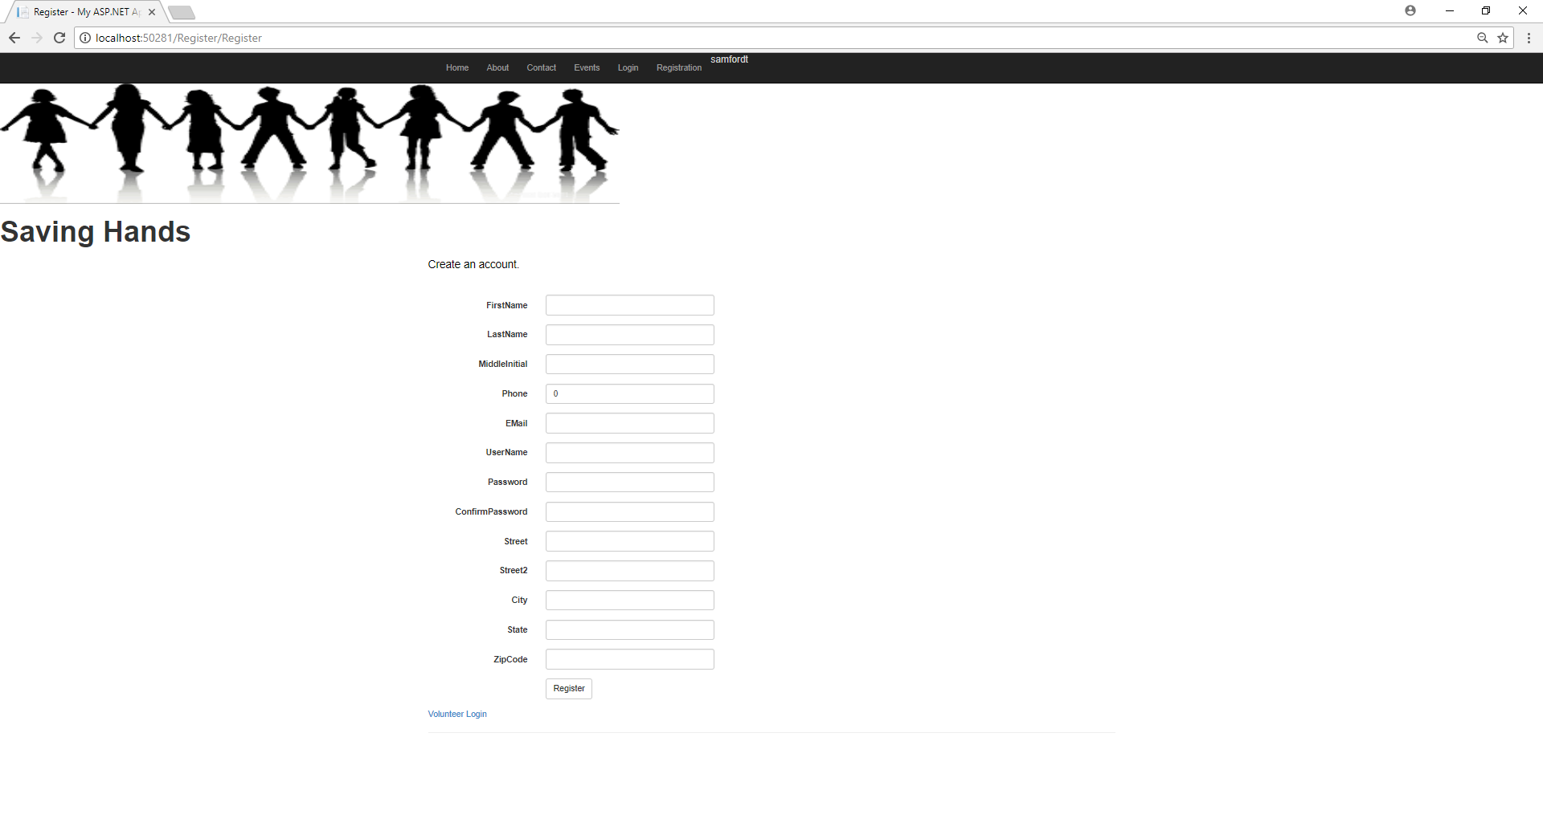

Slide 30
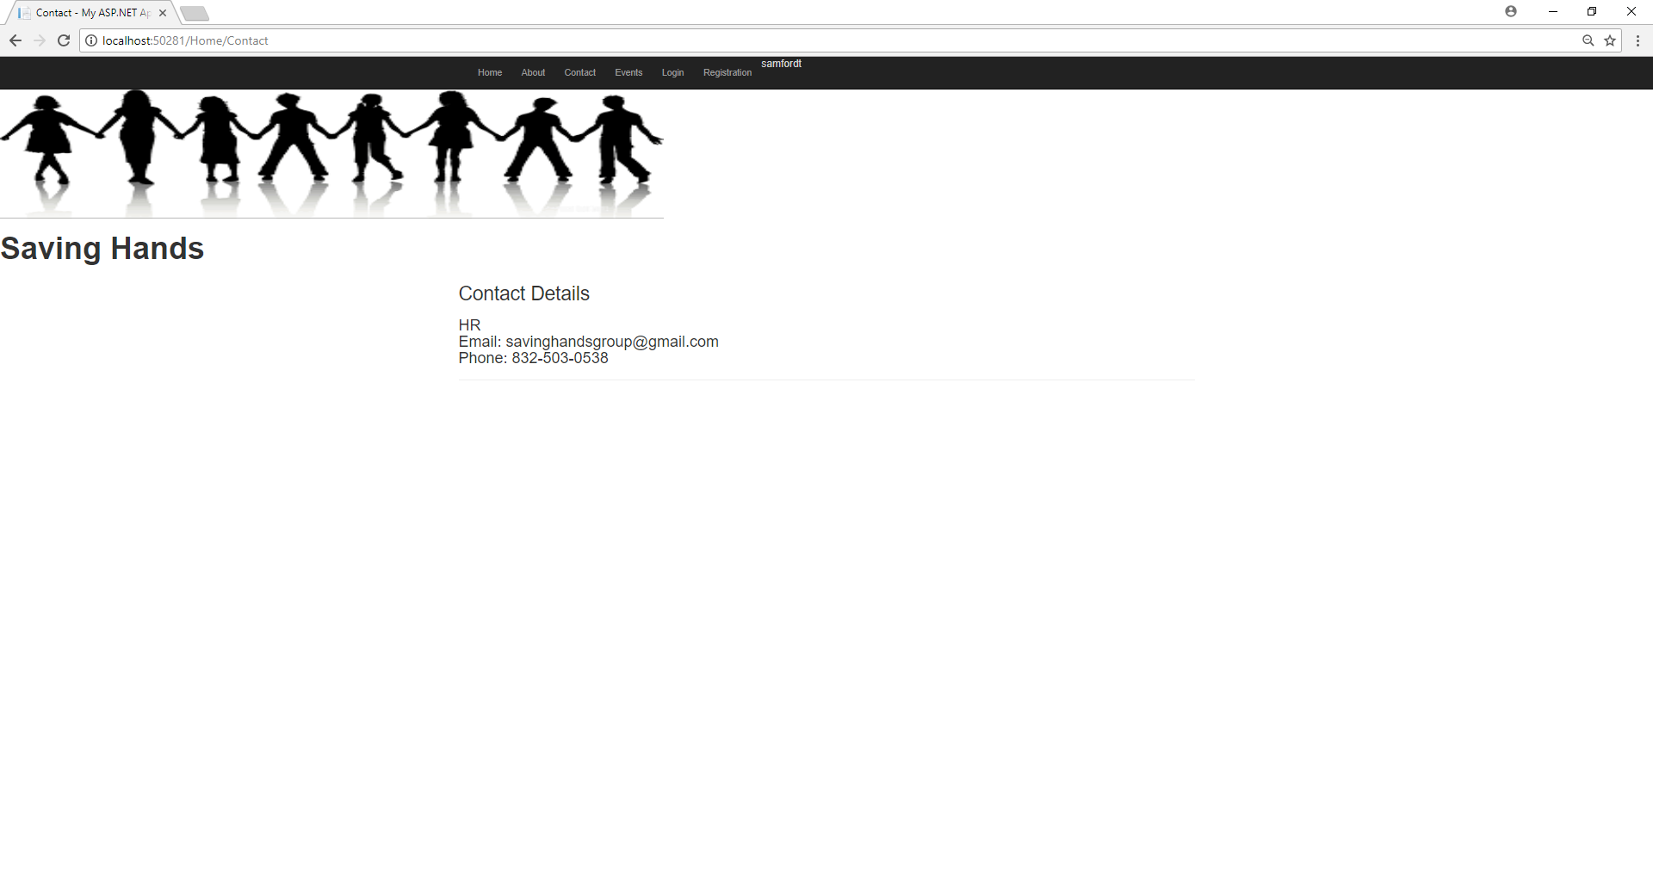
Contact Us Page

Slide 31
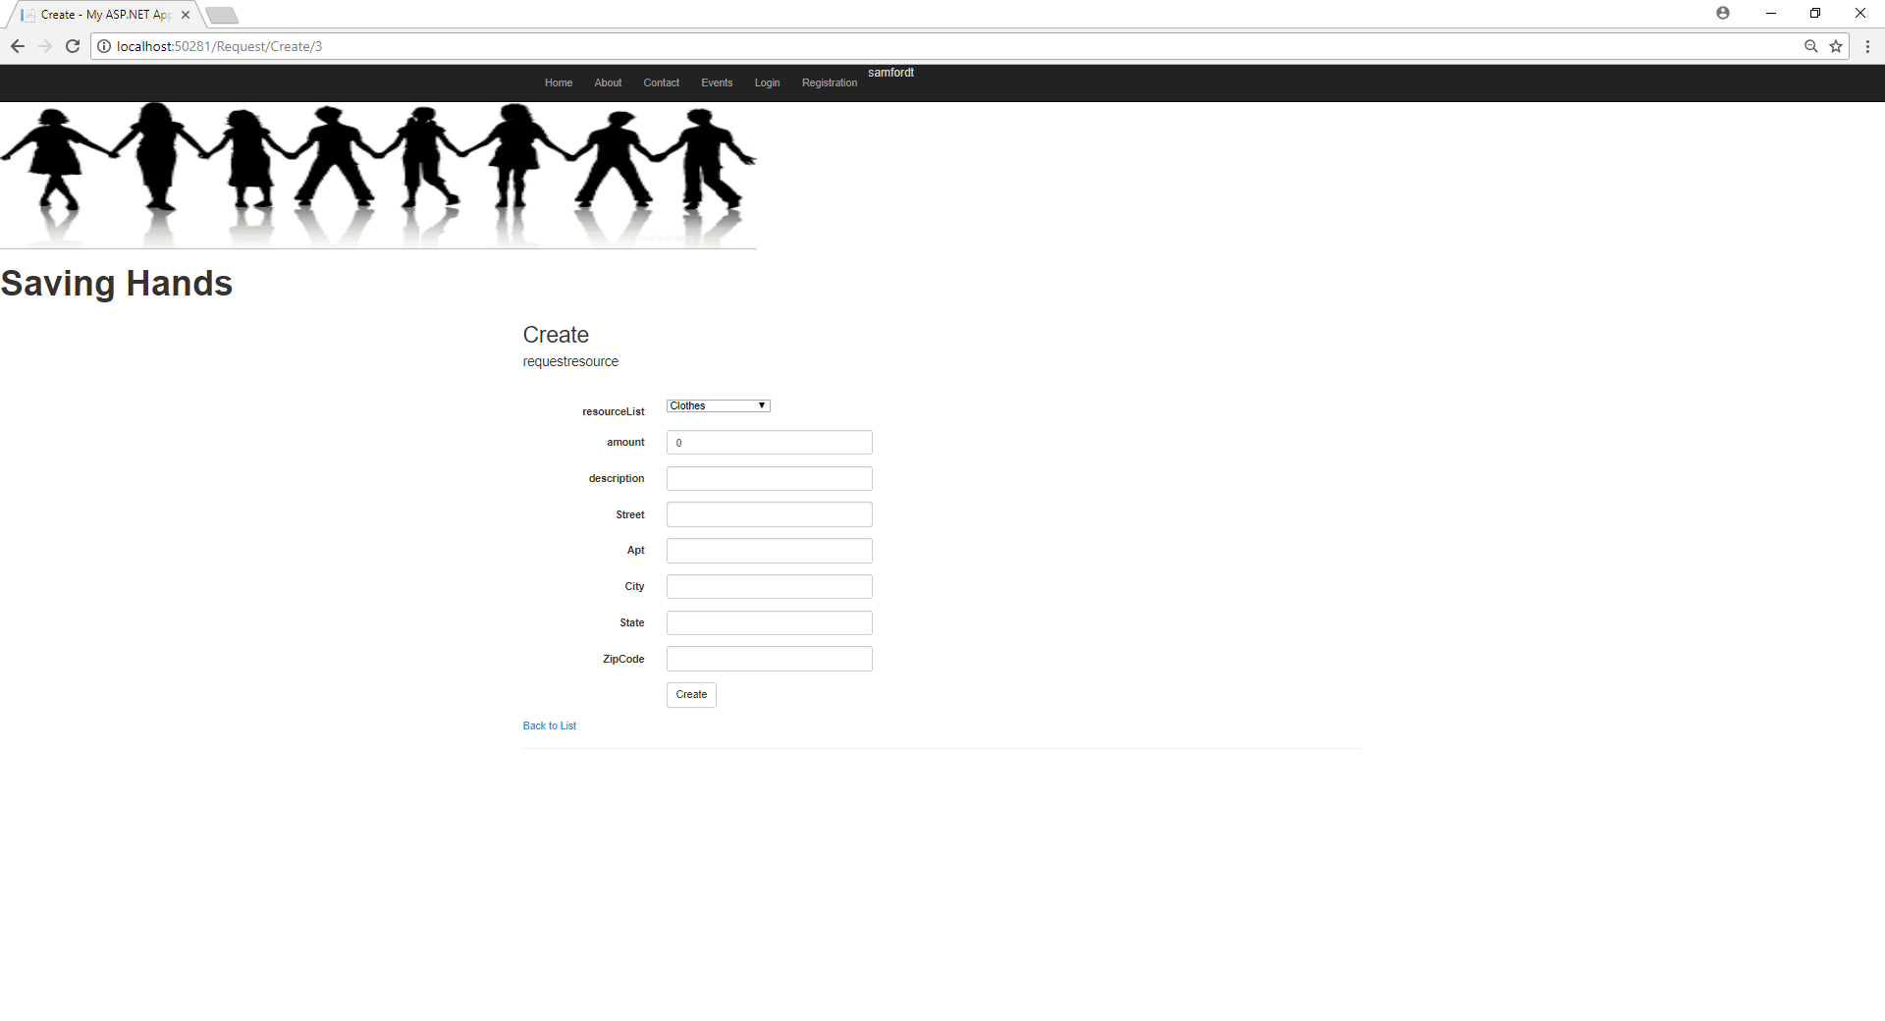
Request Page

Slide 32
Sprint
3
Let’s go with the third sprint and experiences.

Slide 33
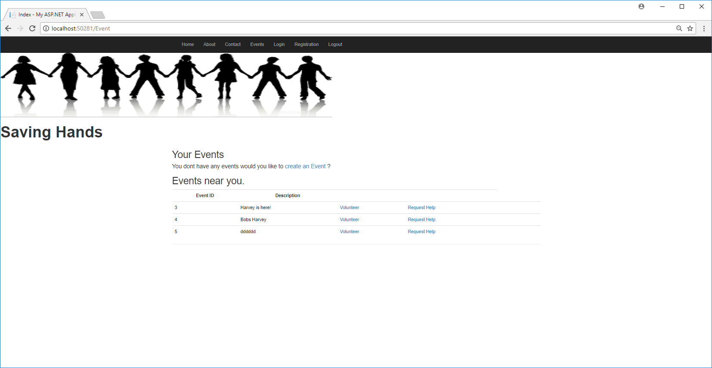

Slide 34
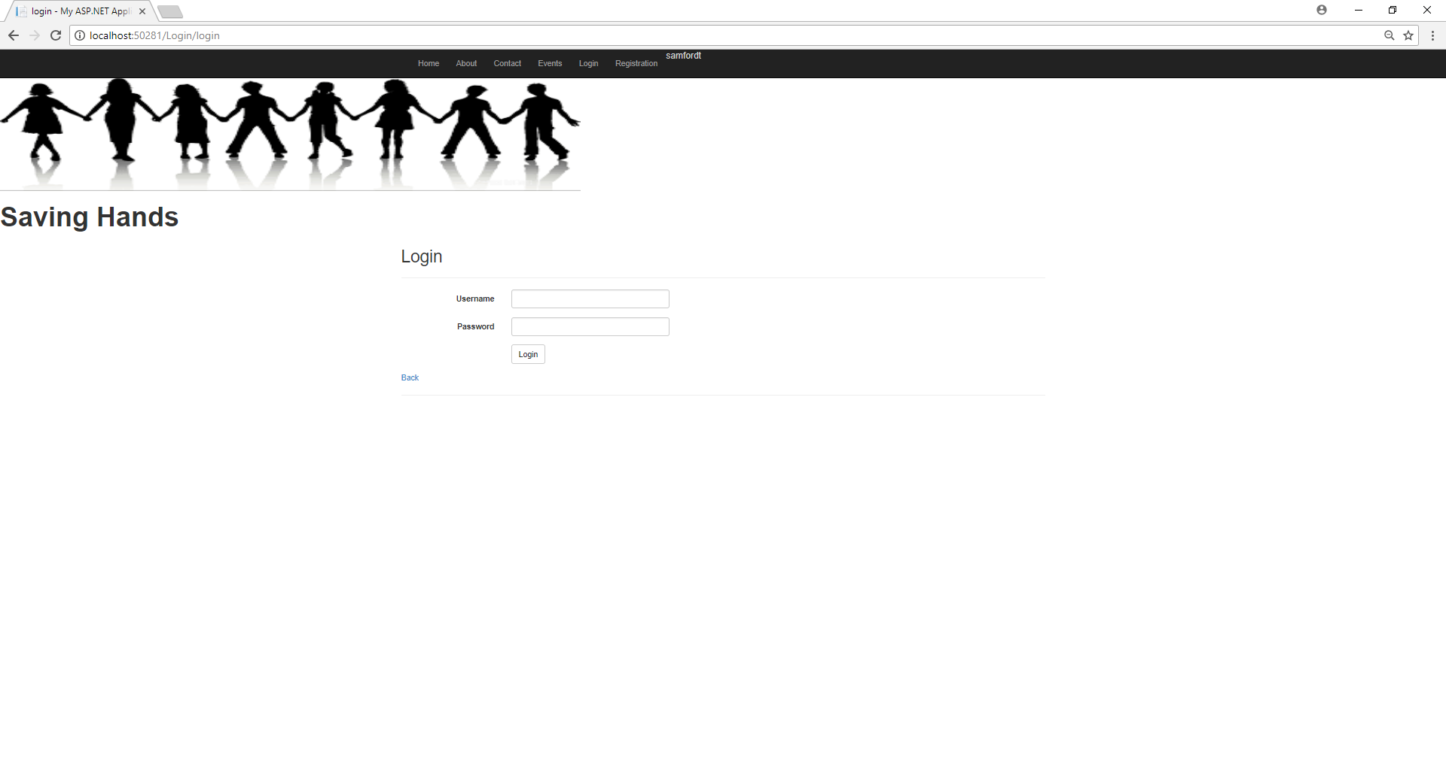
Login Page

Slide 35
Sprint
4
Let’s go with the fourth sprint and experiences.

Slide 36
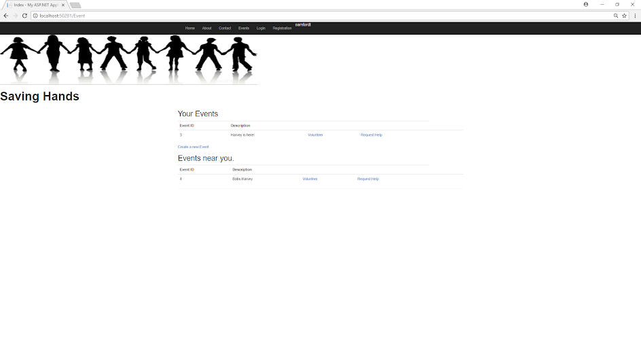

Slide 37
Sprint
5
Let’s go with the fifth sprint and experiences.

Slide 38
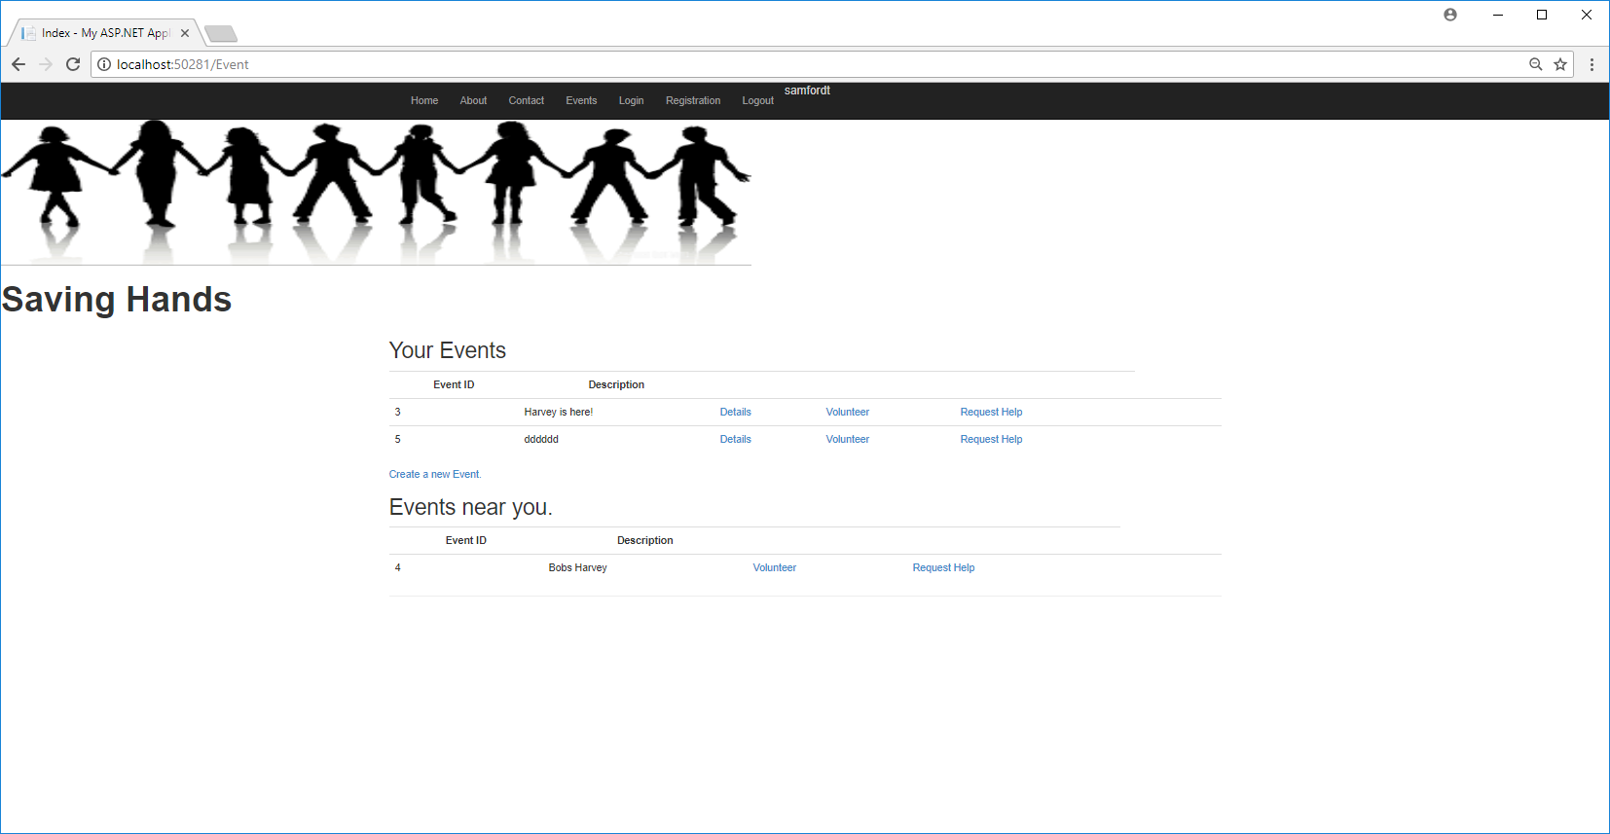
Events Page

Slide 39
Sprint
6
Let’s go with the sixth sprint and experiences.

Slide 40
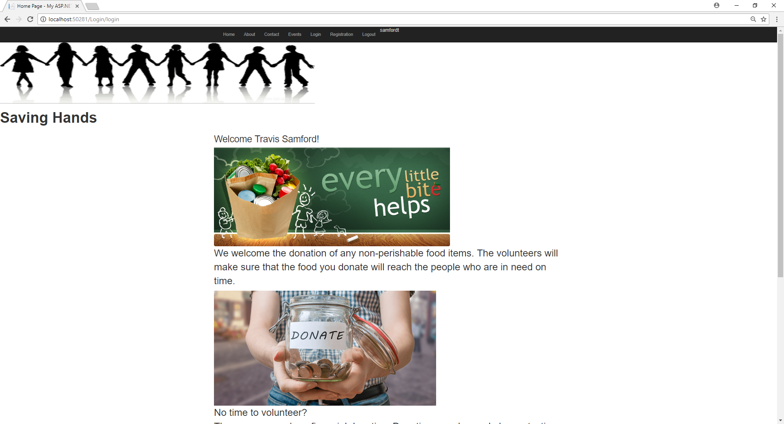
Logout Button

Slide 41
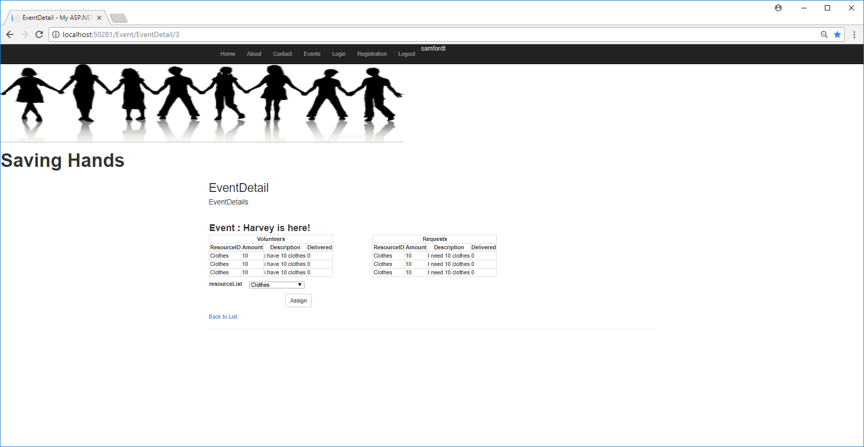
Events Detail Page

Slide 42
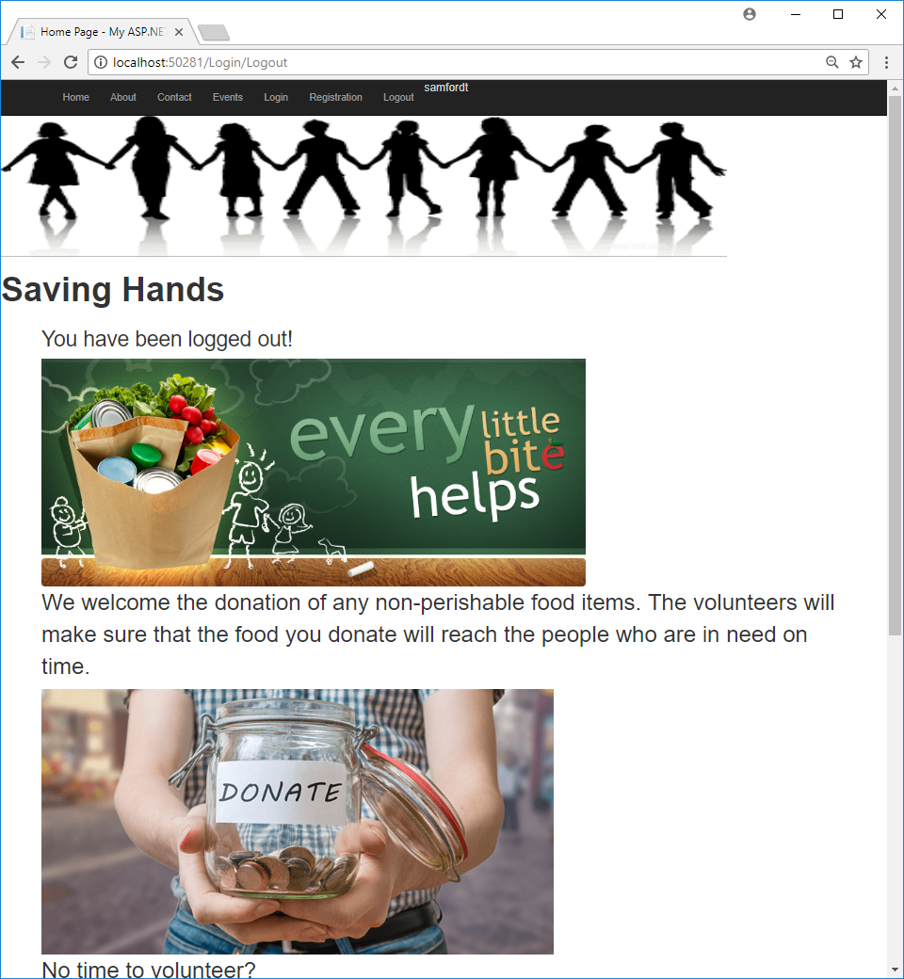
Shows Logging Out

Slide 43
Design
The diagrams which tell about how our website works.

Slide 44
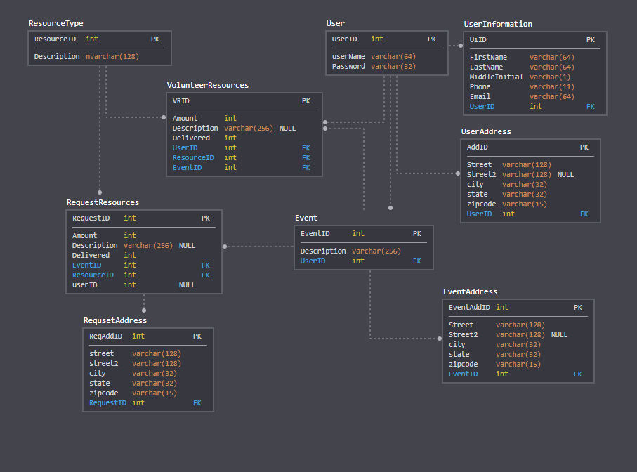
ER Diagram

Slide 45
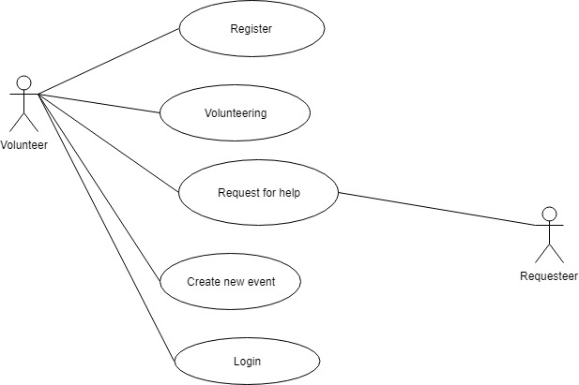
Use case Diagram

Slide 46
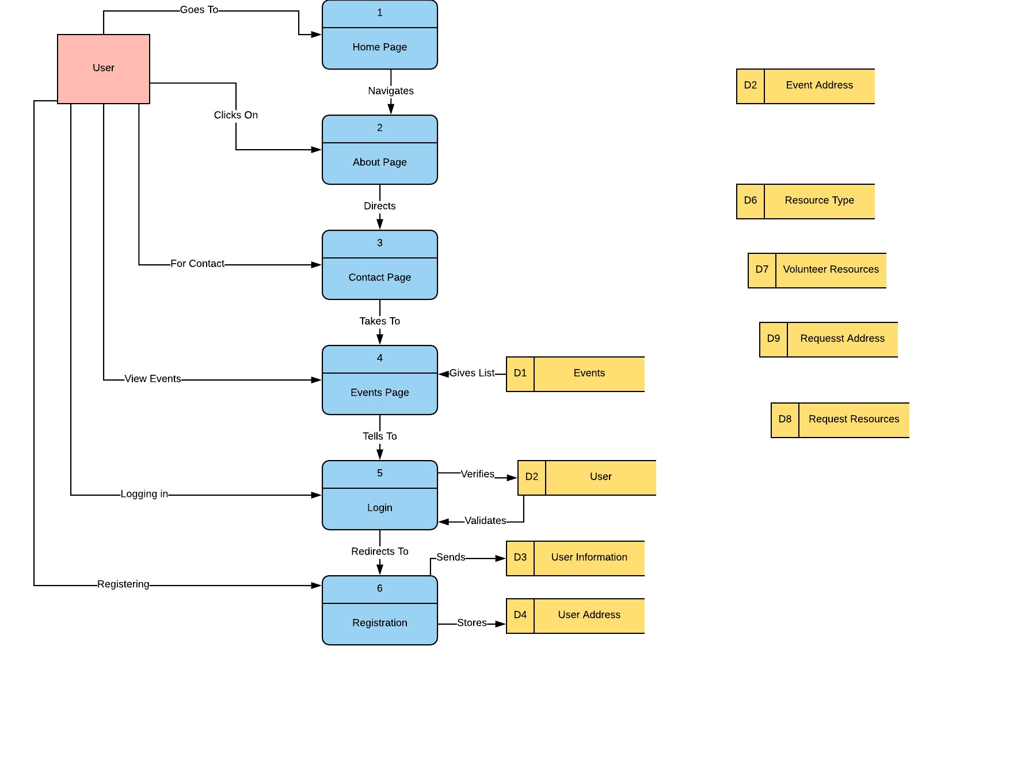
Data Flow Diagram

Slide 47
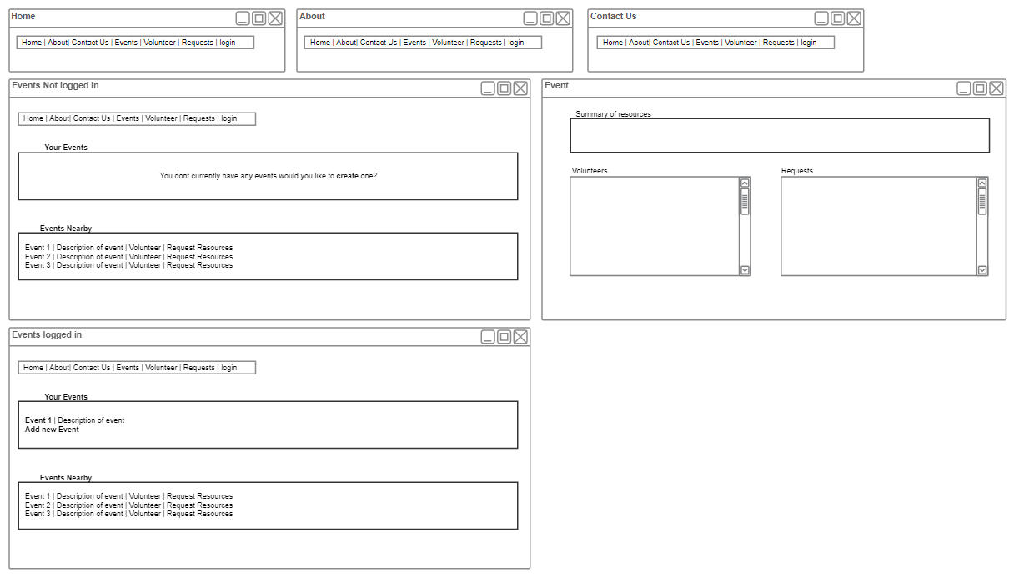
Events Tab MockUp

Slide 48
Assignment Problem
The assignment problem is one of the fundamental combinatorial optimization problems in the branch of optimization or operations research in mathematics.

Slide 49
In general terms,Assignment problem finds the path to do the task with minimal cost.

Slide 50
Hungarian Method
This method is for assigning jobs by a one-for-one matching to identify the lowest-cost solution. Each job must be assigned to only one machine. It is assumed that every machine is capable of handling every job.

Slide 51
Steps in Hungarian Method
Step 1: Select the smallest value in each row.Subtract this value from each value in that row
Step 2: Do the same for the columns that do not have any zero value.If not finished, continue with other columns.
Step 3: Assignments are made at zero values.
Note:
No.of columns should be equal to rows
The costs or values associated with each assignment combination should be known and fixed.

Slide 52

Let us solve an Example

Slide 53
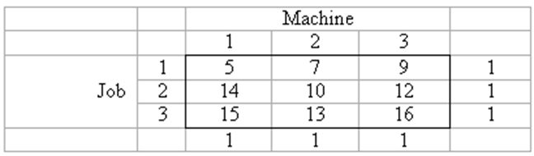
Example Problem

Slide 54
Minimal cost obtained =?

Slide 55

Test Cases

Slide 56
Principles of Agile Testing
Testing is not a phase.
Testing moves the project forward.
Everyone tests.
Shortening feedback response time
Clean code.

Slide 57
How Testing was Implemented?
Get involved in the development process as early as possible.
Test frequently, thoughtfully.
Hit the ground running with test creation.

Slide 58
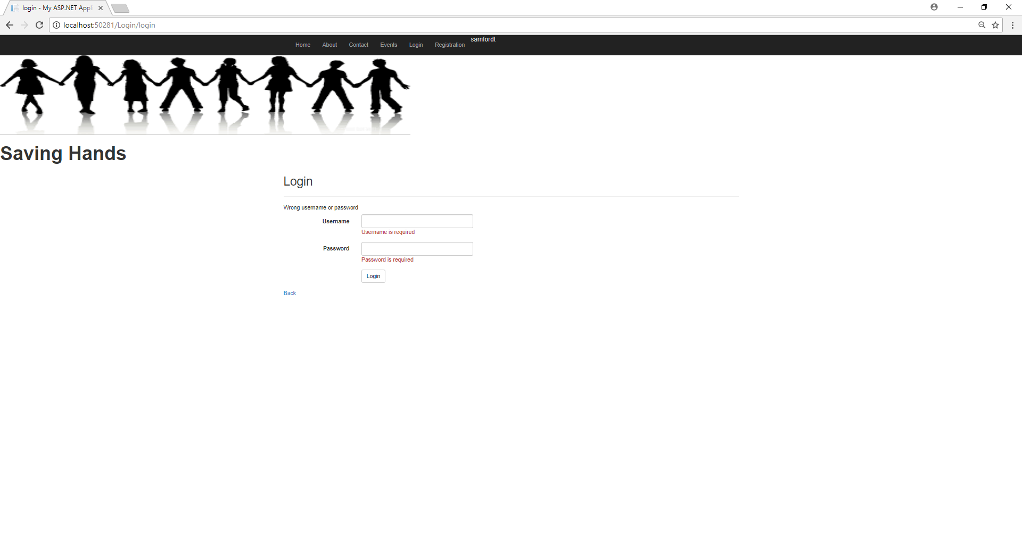

Slide 59
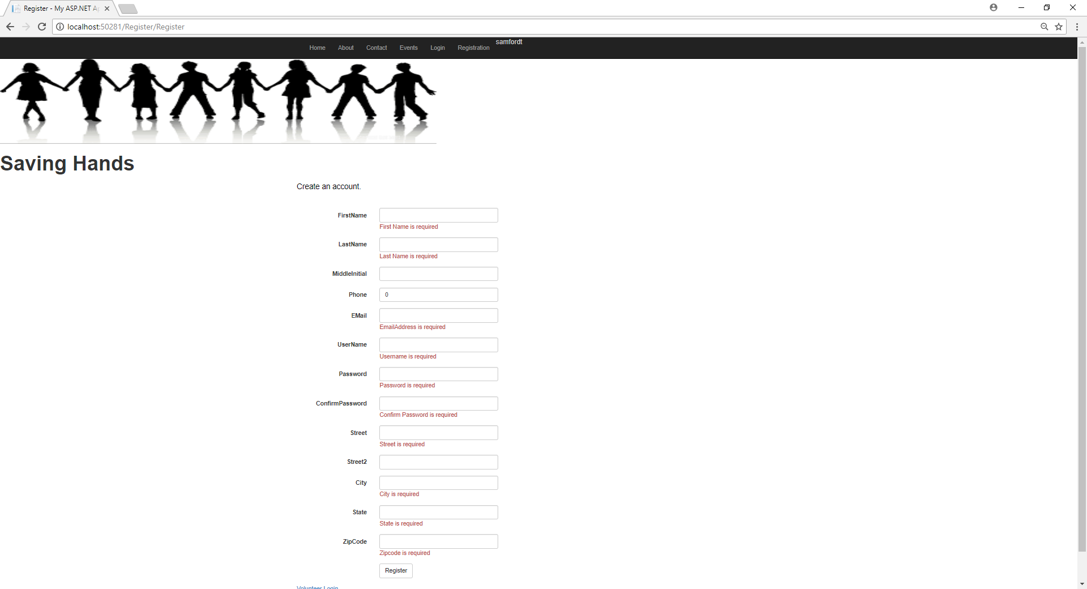

Slide 60
Important Parts of Testing
Communication
Skill Diversity
Business Mindset

Slide 61
TEST CASES
https://docs.google.com/spreadsheets/d/1JuEvLHpjr5pRCGMgcBG8XpzTvBEuhZahIAgDeQLoTqE/edit?usp=sharing

Slide 62

Demo

Slide 63
Future
Distance Feature
Structuring the events in more detail
Improve the volunteer profiles
Complex resource types

Slide 64

Conclusion
Using Scrum,Kanban and XP methodologies we could deliver executable product by meeting needs and returning “value” to customer.

Slide 65
Thanks!
Any questions?

